Slide 1
Heap Dump Analysis using Eclipse Memory Analyzer (MAT)
A guide to identifying memory issues and optimizing Java applications

Slide 2
Agenda
1. Introduction to Heap Dumps
2. Overview of Eclipse MAT
3. Key Concepts
- Shallow vs Retained Size
- Incoming & Outgoing References
4. Dominator Tree
5. Leak Suspect Report
6. Types of OutOfMemoryError (OOME)
7. Best Practices
8. Useful Resources

Slide 3
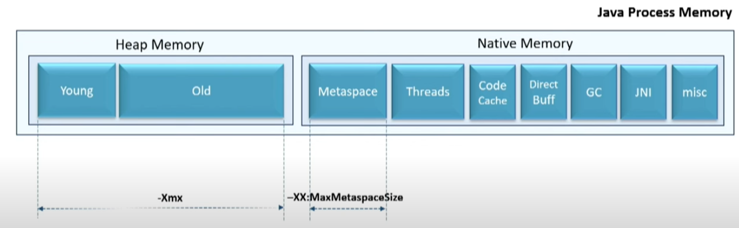
Java Process Memory

Slide 4
What is a Heap Dump?
- A snapshot of the memory of a Java process at a given time.
- Captures all live objects and their references.
- Used for diagnosing memory leaks and analyzing memory usage.
Link: https://docs.oracle.com/javase/8/docs/technotes/guides/troubleshoot/memleaks002.html

Slide 5
What is Eclipse Memory Analyzer?
- A powerful tool to analyze heap dumps.
- Helps detect memory leaks and reduce memory consumption.
- Supports large heap dumps (GBs in size).
Link: https://www.eclipse.org/mat/

Slide 6
Shallow vs Retained Size
- Shallow Size: Memory consumed by the object itself.
- Retained Size: Total memory that will be freed when the object is garbage collected.
Link: https://blog.gceasy.io/shallow-heap-retained-heap/

Slide 7
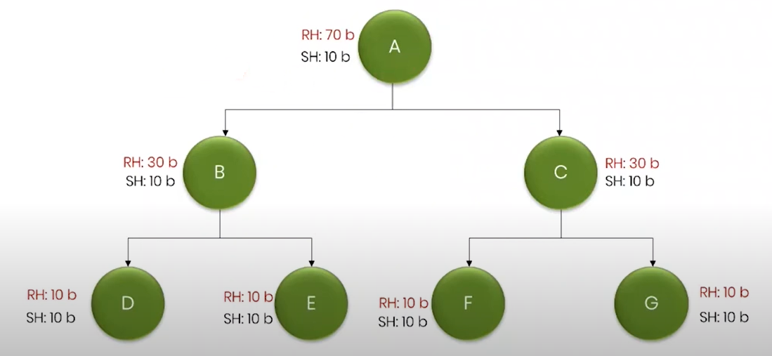
Shallow vs Retained Size

Slide 8
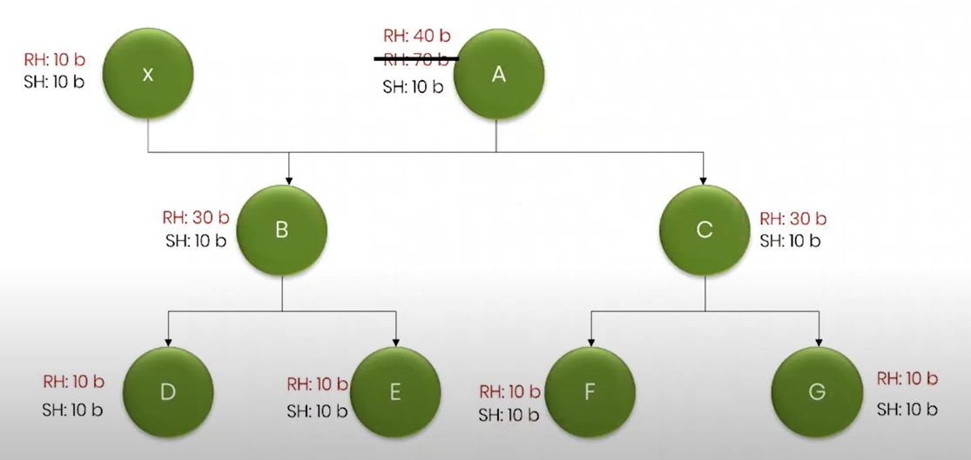
Shallow vs Retained Size

Slide 9
Incoming & Outgoing References
- Incoming: References pointing to the current object.
- Outgoing: References from the current object to others.
- Helpful for understanding object reachability and GC roots.
Link: https://blog.gceasy.io/eclipse-mat-incoming-references-outgoing-references/#:~:text=Incoming%20References%20of%20object%20C,and%20uploaded%20to%20Eclipse%20MAT.

Slide 10
Dominator Tree
- Shows objects retaining the most memory.
- Helps identify memory leaks and retention paths.
- The root object dominates everything else.
Link: https://help.eclipse.org/latest/index.jsp?topic=/org.eclipse.mat.ui.help/welcome.html

Slide 11
Leak Suspect Report
- Automatically generated report highlighting:
- Dominator objects
- Paths to GC roots
- Suspected leaks
Link: https://www.eclipse.org/mat/documentation/userguide/reports.html

Slide 12
Common OutOfMemoryErrors
- java.lang.OutOfMemoryError: Java heap space
- java.lang.OutOfMemoryError: GC overhead limit exceeded
- java.lang.OutOfMemoryError: Metaspace
- java.lang.OutOfMemoryError: Unable to create new native thread
Link: https://docs.oracle.com/javase/8/docs/technotes/guides/troubleshoot/memleaks002.html

Slide 13
Best Practices for Heap Dump Analysis
- Always generate full heap dumps.
- Use filters and grouping (by class, package).
- Analyze retained size to detect memory retention.
- Compare dumps over time.
- Automate with scripts if recurring issues.
Link: https://blog.ycrash.io/eclipse-mat-tidbits/

Slide 14
How to Generate Heap Dumps
- Using jmap:
jmap -dump:format=b,file=heap.hprof <pid>
- Via JVM options on OOME:
-XX:+HeapDumpOnOutOfMemoryError -XX:HeapDumpPath=/path
Link: https://docs.oracle.com/javase/8/docs/technotes/guides/troubleshoot/tooldescr014.html

Slide 15
Tools Comparison
Tool | Pros | Cons
--------------------|------------------------------|-----------------------------
Eclipse MAT | Fast, visual, detailed | UI can be overwhelming
VisualVM | Integrated with JDK | Less powerful for large dumps
JProfiler/YourKit | Commercial, advanced | Expensive

Slide 16
Useful Resources
📘 Eclipse MAT Documentation: https://help.eclipse.org/latest/index.jsp?topic=/org.eclipse.mat.ui.help/welcome.html
📘 Understanding Memory Leaks in Java: https://www.baeldung.com/java-memory-leaks
📘 How can we analyze JAVA memory issues
https://medium.com/@prabhashdilhanakmeemana/how- can-we-analyze-java-memory-issues-java-lang-outofmemoryerror-cf41d3643ba5

Slide 17
Summary
- Heap dumps offer deep insights into memory.
- Eclipse MAT is ideal for detailed analysis.
- Key metrics: retained size, dominator tree, leak suspects.
- Regular analysis helps prevent OOMEs and optimize memory.

